Slide 1
OOPs CONCEPT
-PREPARED BY
ARUNA B
BATCH : 2024-12826

Slide 2
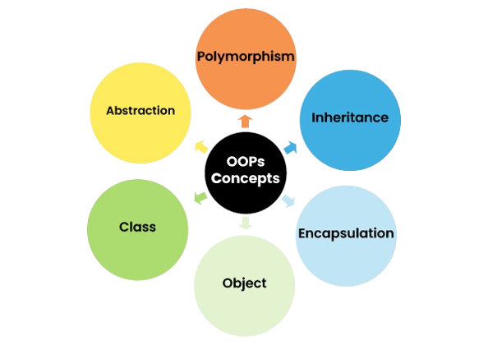

Slide 3
CLASS
Class is not a real-world entity. It is just a template or blueprint or prototype from which objects are created.
Class does not occupy memory.
SYNTAX:
class ClassName
{
// Data members
// Functions
// main method
}

Slide 4
OBJECT
Objects are the instances of a class that are created to use the attributes and methods of a class.
Creating an object is also called as instantiating a class.
A single class may have any number of instances.
SYNTAX:
ClassName ObjectName = new ClassName();

Slide 5
EXAMPLE FOR CLASS AND OBJECT
class Student {
int id = 10;
String name =“Aruna”;
public static void main(String args[])
{
Student s1 = new Student(); // Creating an object of Student class
System.out.println(s1.id);
System.out.println(s1.name);
}
}
OUTPUT:
10
Aruna

Slide 6
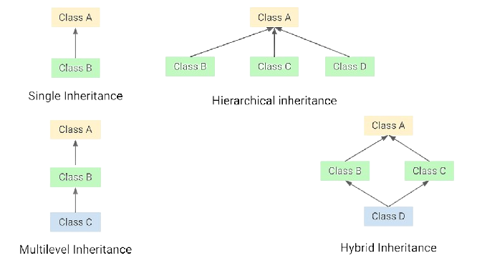
INHERITANCE
One class is allowed to inherit the features(fields and methods) of another class.
A class that inherits from another class can reuse the methods and fields of that class.
Allowing us to create flexible and reusable code.
Extends key word is used to inherit the parent class object

Slide 7
EXAMPLE FOR INHERITANCE
import java.io.*;
class Employee { //Parent class
int salary = 60000;
}
class Engineer extends Employee { // Child class
int benefits = 10000;
}
class Gfg {
public static void main(String args[])
{
Engineer E1 = new Engineer(); //Object is created for child class
System.out.println("Salary : " + E1.salary + "\nBenefits : " + E1.benefits);
}
}
OUTPUT:
Salary: 60000
Benefits: 10000

Slide 8
POLYMORPHISM
Single action in different ways.
“poly” means many and “morphs” means forms, So it means many forms.
POLYMORPHISM
COMPILE-TIME POLYMORPHISM
RUN TIME POLYMORPHISM

Slide 9
EXAMPLE FOR POLYMORPHISM
class Helper {
static int Multiply(int a, int b) //Compile time and Run time
{ return a * b; }
static double Multiply(double a, double b) // Compile time
{ return a * b; }
static int Multiply(int a, int b,int c) // Run time
{ return a * b*c; }
}
class GFG {
public static void main(String[] args)
{
System.out.println(Helper.Multiply(2, 4));
System.out.println(Helper.Multiply(5.5, 6.3));
System.out.println(Helper.Multiply(1,2,3));
}
}
OUTPUT:
8
34.65
6

Slide 10
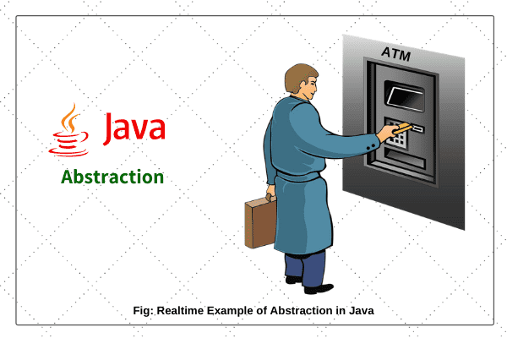
ABSTRACTION
Only show essential details/functionality to the user. The non-essential implementation details are not displayed to the user.
Real world example : Ordering a food in hotel. ATM money withdrawal.

Slide 11
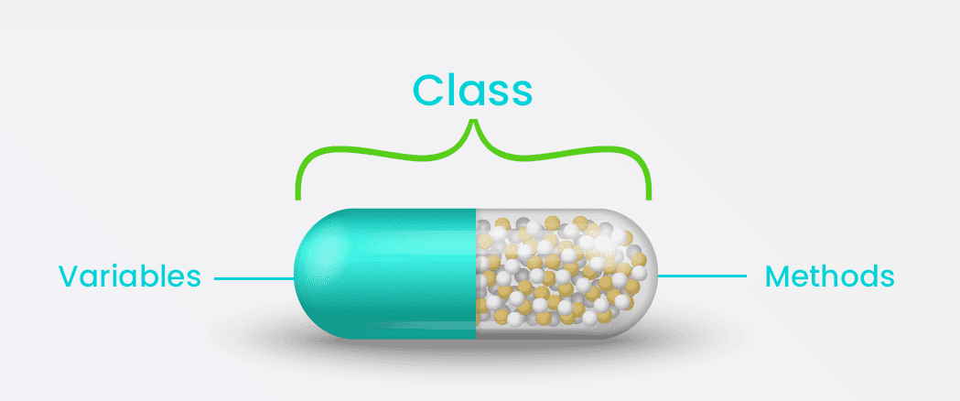
ENCAPSULATION
Way of hiding the implementation details of a class from outside access and only exposing a public interface that can be used to interact with the class.
In Java, encapsulation is achieved by declaring the instance variables of a class as private, which means they can only be accessed within the class.
To allow outside access to the instance variables, public methods called getters and setters are defined, which are used to retrieve and modify the values of the instance variables, respectively.
By using getters and setters, the class can enforce its own data validation rules and ensure that its internal state remains consistent.

Slide 12
EXAMPLE FOR ENCAPSULATION
class Person {
private String name; // private data variables
private int age;
public String getName() { return name; } //getter
public void setName(String name) { this.name = name; } // setter
public int getAge() { return age; }
public void setAge(int age) { this.age = age; }
}
public class Main {
public static void main(String[] args) {
Person person = new Person();
person.setName("John");
person.setAge(30);
System.out.println("Name: " + person.getName());
System.out.println("Age: " + person.getAge());
} }
OUTPUT:
Name: John
Age: 30

Slide 13
THANK YOU

